Slide 1
Brain Tumor Detection
Muzamil Shafique (SP22-BCS-008)
Hamza javed (SP22-BCS-074)
Muhammad Hamza (SP22-BCS-101)

Slide 2
introduction
• Brain tumour is one of the most dangerous diseases which require early and accurate detection methods.
• Now most detection and diagnosis methods depend on decision of neurospecialists, and radiologist for image evaluation which is possible to human errors and is time consuming.
• The main purpose of this project is to build a robust CNN model that can classify if the subject has a tumour or not based on Brain MRI scan images with an acceptable accuracy for medical grade application.

Slide 3
Objectives
Designing and implementing algorithms for preprocessing brain imaging data to enhance image quality and standardize intensity characteristics.
Developing segmentation algorithms to accurately extract edges of tumor regions within brain images while minimizing false positives and false negatives.
Implementing classification techniques to differentiate between tumor and non-tumor regions based on extracted features.
Evaluating the accuracy, efficiency, and usability of the system through rigorous testing and validation.

Slide 4
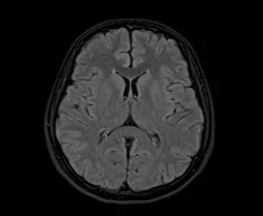
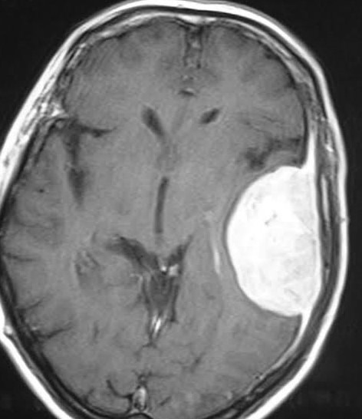
Dataset
Dataset contains a diverse collection of MRI images with varying size, texture and intensity of brain of patients having tumor as well as healthy patients.
Healthy Brain
Brain with Tumor

Slide 5
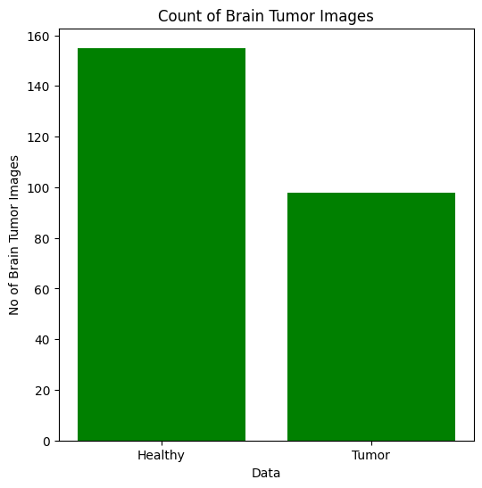
Dataset sTastistics

Slide 6
Image Preprocessing
Input Image
Image merging
Image reshaping
Image resizing
Image splitting
Preprocessed Image

Slide 7
Convolutional Neural network
Convolutional Neural Networks (CNNs) was used to perform feature extraction from input images and training our model for detecting brain tumors in MRI scans.
The network starts with two convolutional layers.
First Convolutional Layer:
Input: Takes an input image with 3 channels (RGB).
Operation: Applies 6 filters (kernels) of size 5x5 to the input image.
Second Convolutional Layer:
Input: Takes the output from the first layer with 6 channels.
Operation: Applies 16 filters of size 5x5.

Slide 8
Convolutional Neural network
Fully Connected Layers:
The output from the convolutional layers is flattened into a one-dimensional vector.
This step is crucial for transitioning from the convolutional part of the network to the fully connected part.
First Fully Connected Layer:
Input Features: 256 (determined by the output size after the convolutional and pooling operations).
Output Features: 120.
Second Fully Connected Layer:
Input Features: 120.
Output Features: 84.

Slide 9
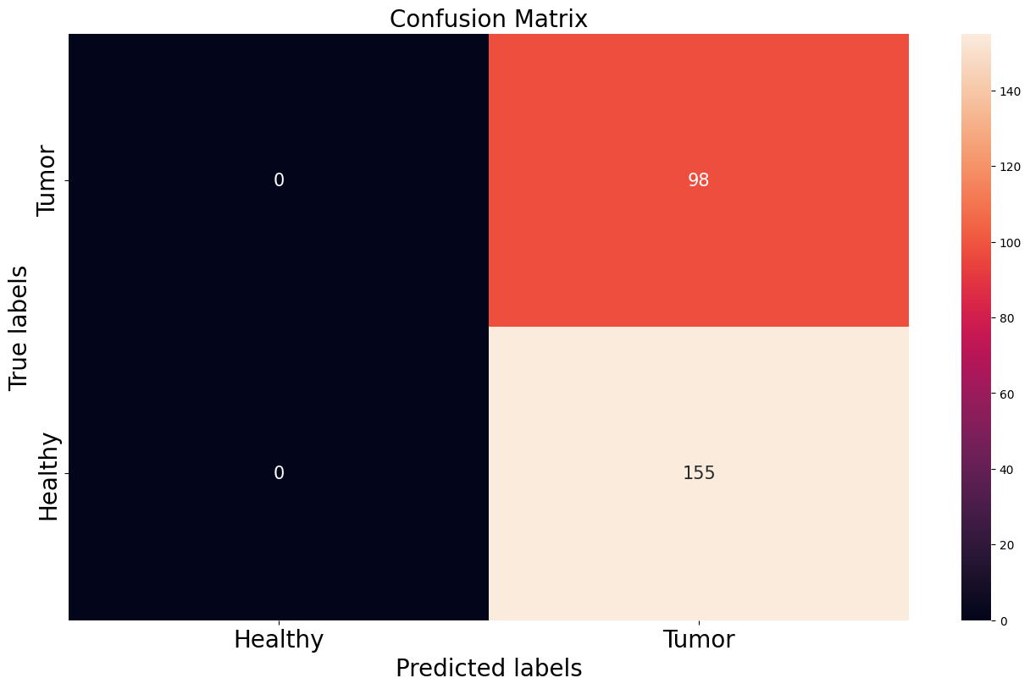
Model before training

Slide 10
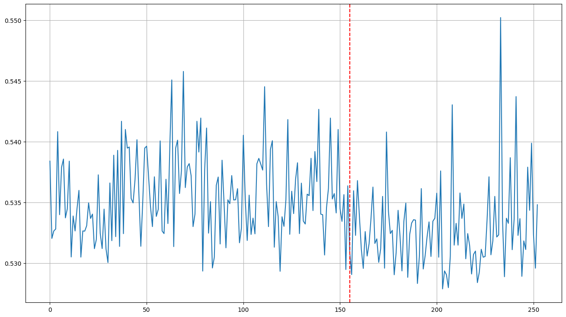
Model before training

Slide 11
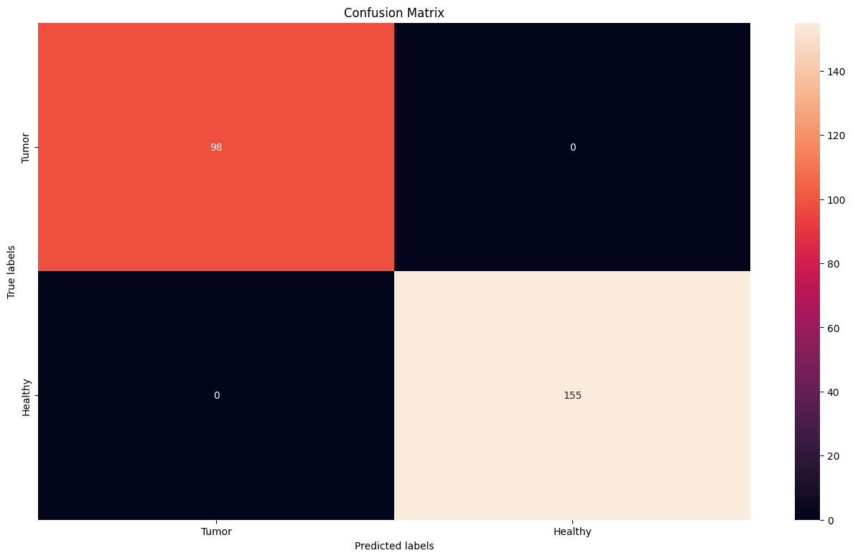
Model After Training

Slide 12
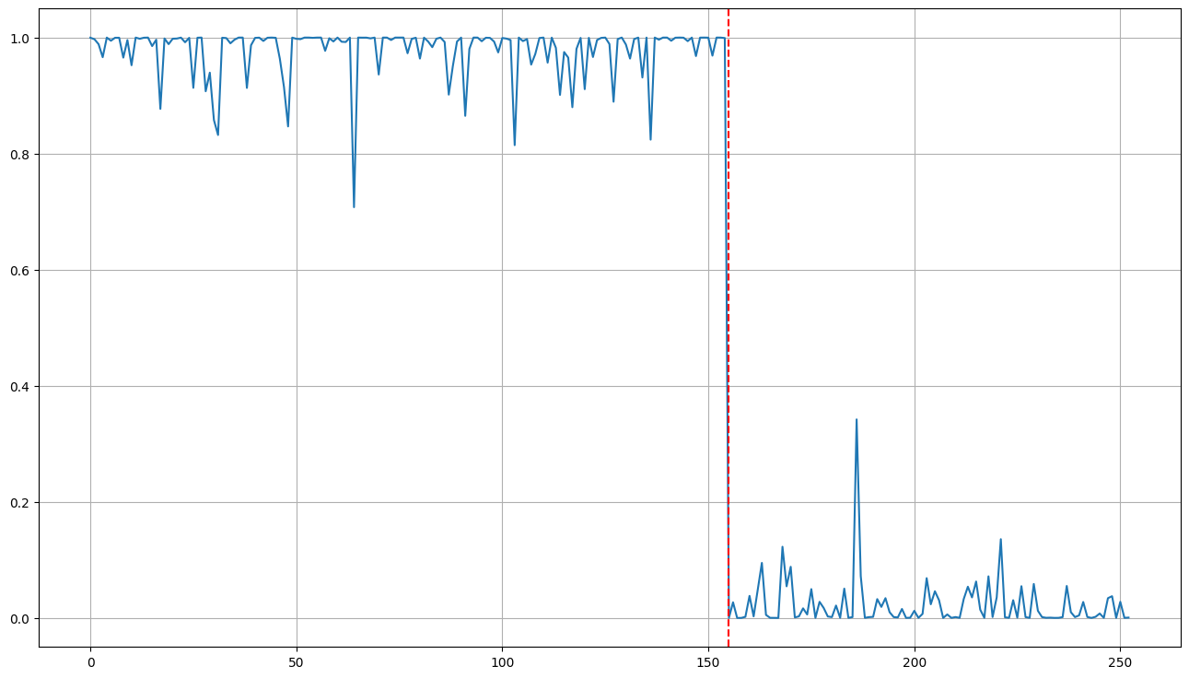
MODEL AFER TRAINING

Slide 13
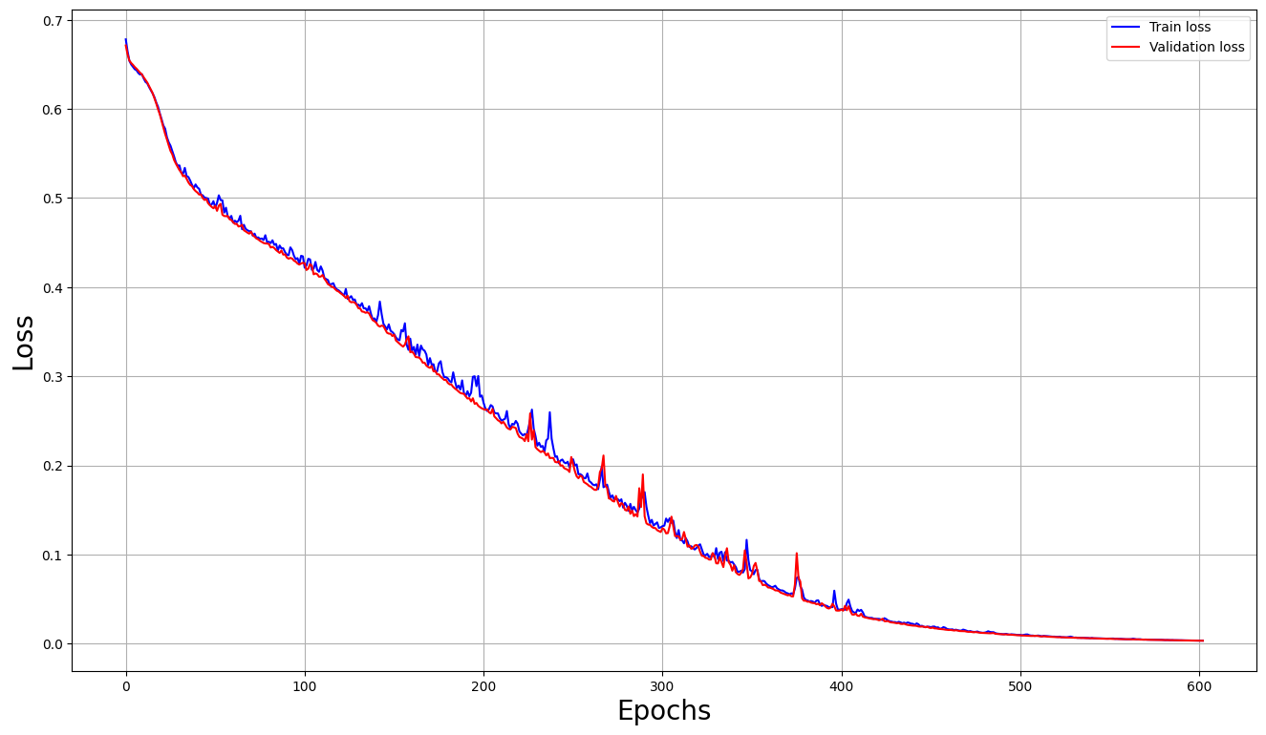
Results

